Slide 1

Campus Marketplace
‘Team A’
Ore
Tess
Hayden
Robert
Radiance
Parisan

Slide 2
CONTENTS
o1
05
02
06
03
07
Overview
System architecture diagram
User personas
ER diagram
Specification
Wireframes
04
Wireframes
08
Walkthrough

Slide 3

Overview
A Campus Marketplace is an application designed specifically for university students to buy and sell second-hand items within their campus community.
The application supports students who are:
Moving into accommodation and need affordable items
Moving out and want to sell unwanted belongings

Slide 4
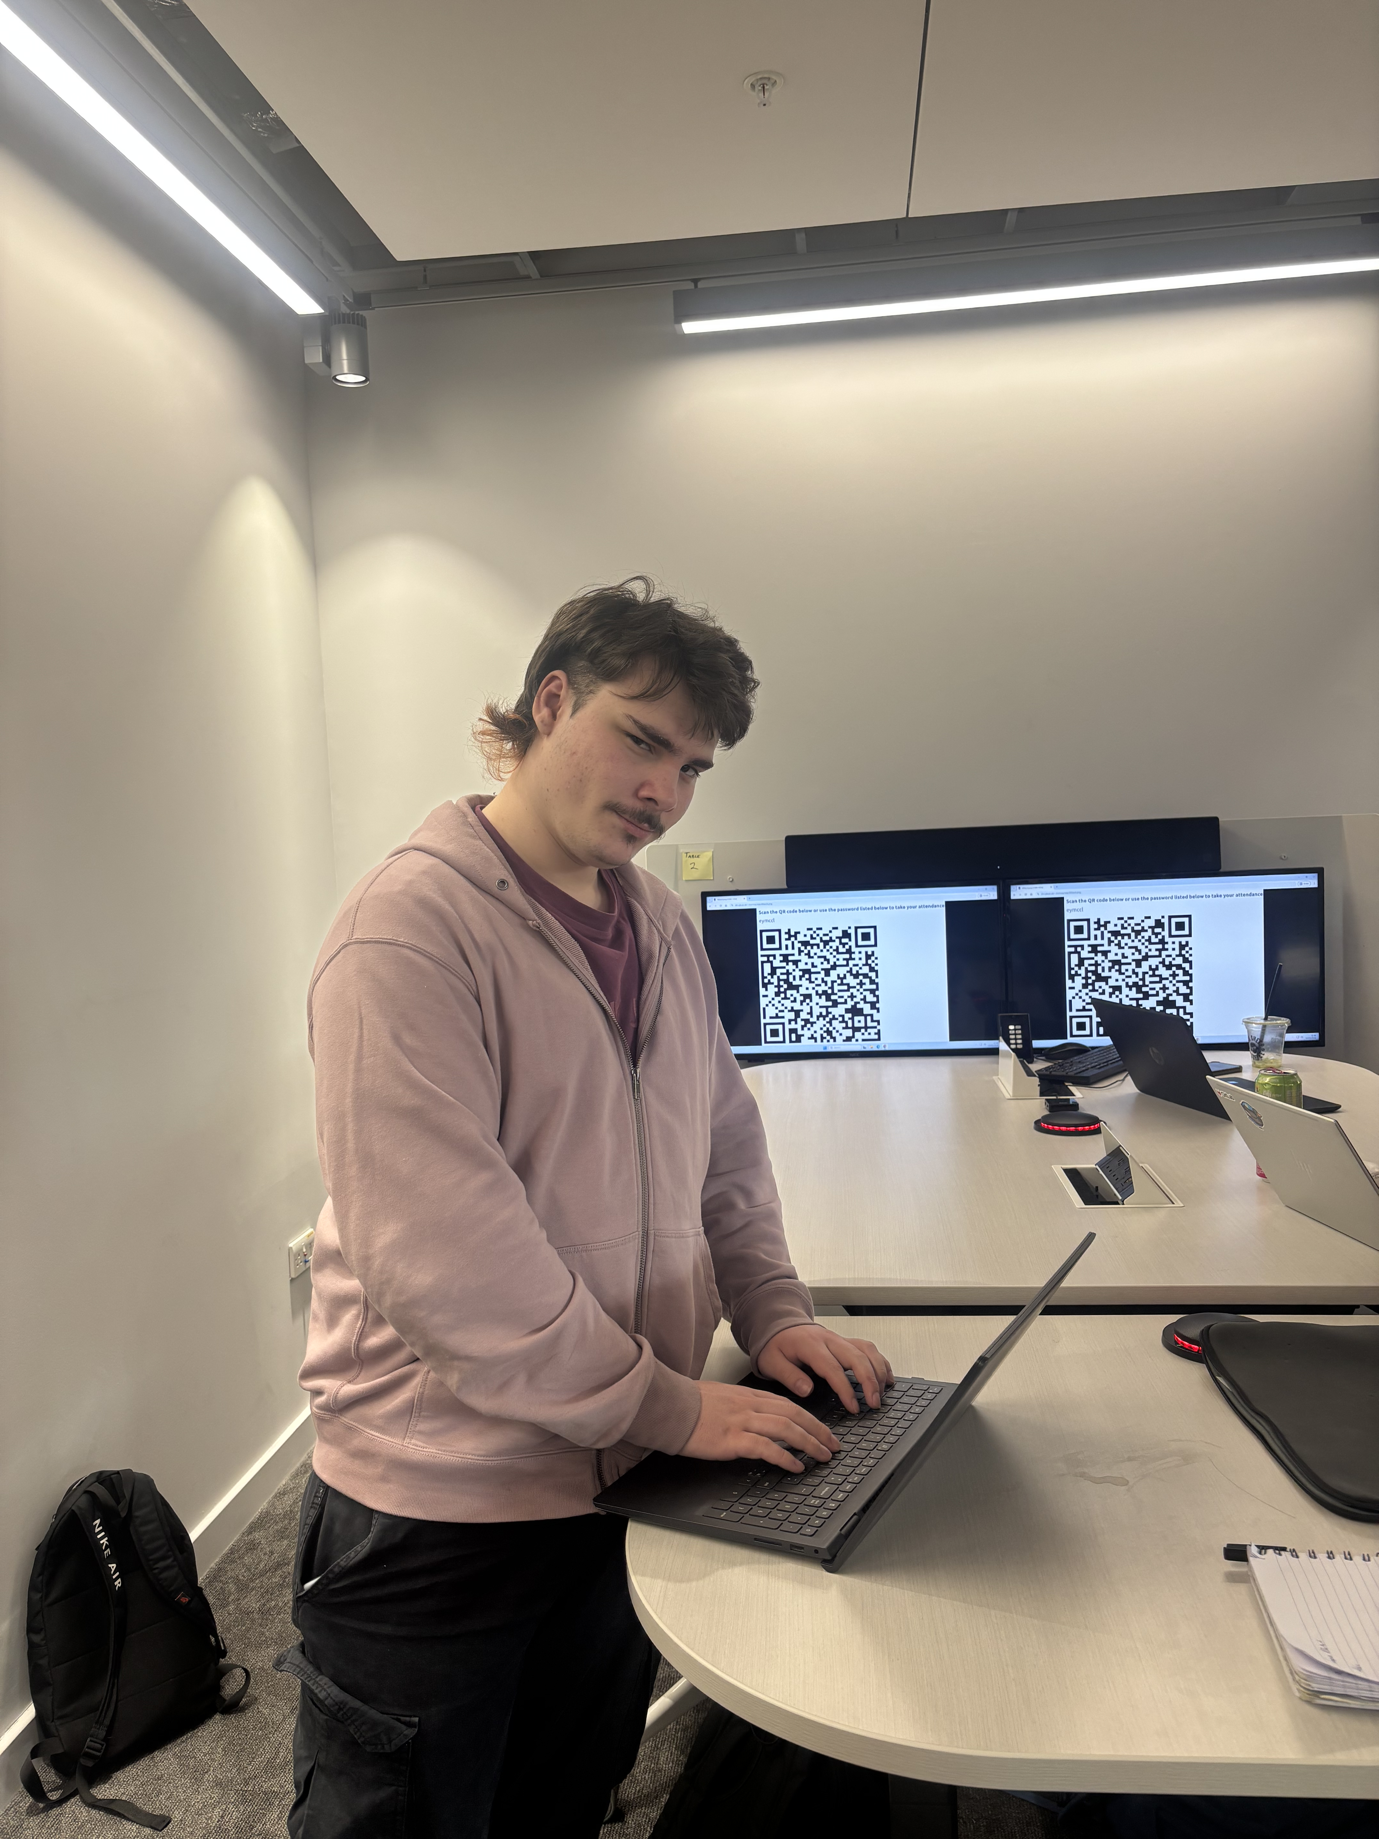
Persona One (Robert)
This is Robert, a student at Glasgow university.
He recently lost a good deal of money while “strategically investing” in card games. He needs money, so naturally decides to gather old belongings and sell them to make some money.
He uses a new website called Campus Marketplace to sell these belongings. Within a short time, another student named Ore had purchased Robert’s items and Robert made some money.

Slide 5
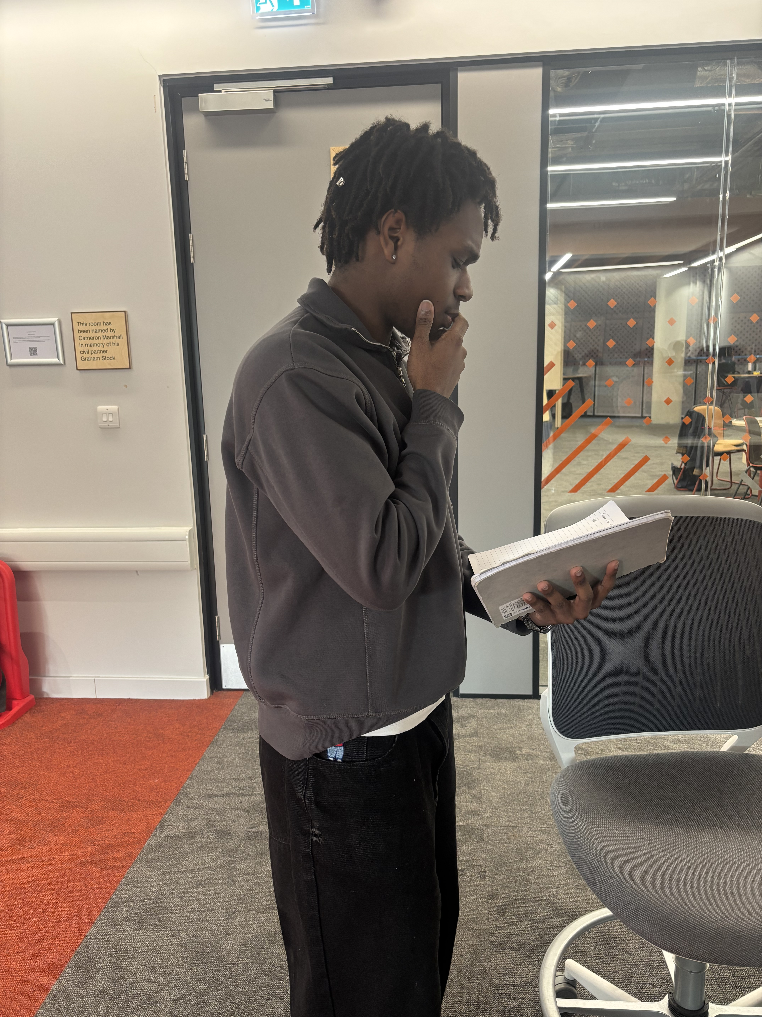
Persona Two (Ore)
This is Ore, a humble student at Glasgow
university. Ore has just moved flat and needs
some bargain items after spending a lot of
money for his accommodation. He uses
Campus Marketplace and finds well-priced
items listed under RobertTheBoss22.
He decides to buy these items and is more than happy with the outcome, and even has a little money left over to spend on “Games of Chance”.

Slide 6
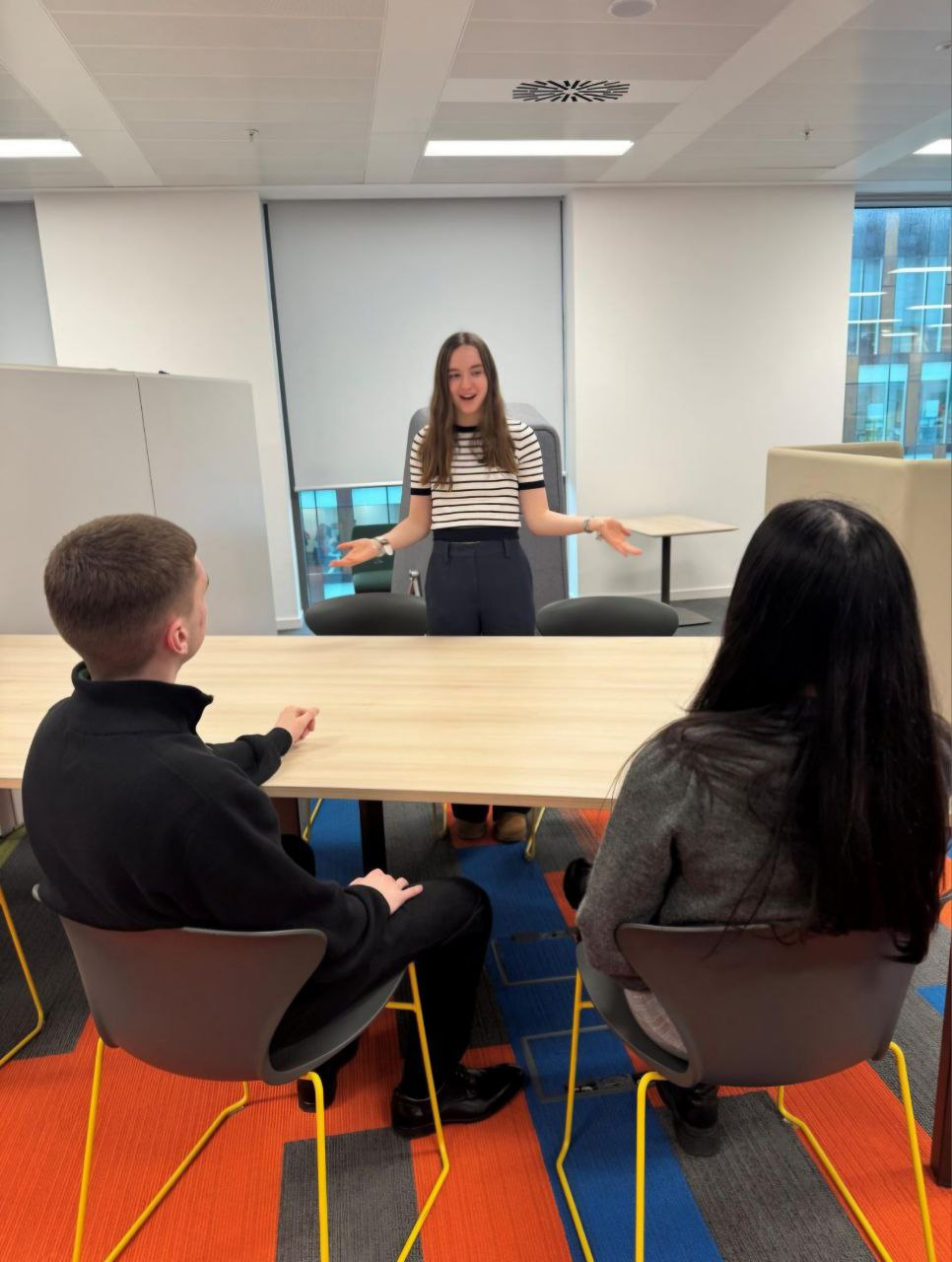
Persona Three (Tess)
This is Tess (middle), she is a lecturer at Glasgow university. She is looking to sell her old stationery (pens, pencils etc.). She figures students will need them with pen and paper exams becoming popular again. She decides to list them on Campus Marketplace and makes some quick cash.

Slide 7
Requirements (MoSCoW)
Must have
Should have
Users must be able to create an account and log in
Users must be able to list items for sale and upload photos for each item
Users must be able to browse and search for items by category or keyword
Users must be able to add and view item descriptions
Users must be able to purchase items using in‑app virtual currency
Users must have a virtual account balance (top‑up functionality)
Users should be able to edit their profile
Users should be able to mark items as sold
Users should be able to view their past purchases and sales
Could have
Users could save items to a wish list for later
Buyers could leave feedback
Won’t have
No actual payment handling
No bidding system
No other universities can be involved

Slide 8
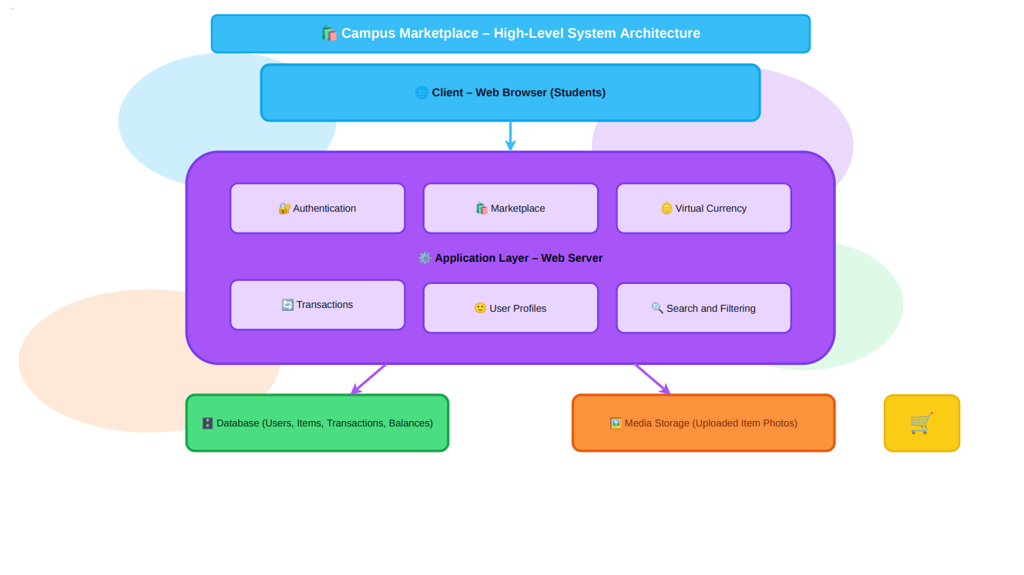
System Architecture Diagram

Slide 9
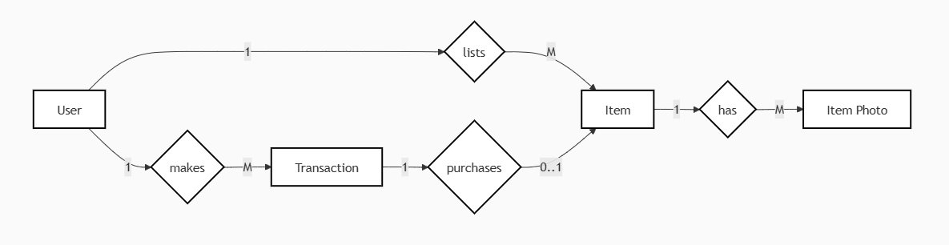
ER Diagram

Slide 10
User entity
Field | Type
userID (PK) | Char(36)
first_name | Char(128)
last_name | Char(128)
email | Char(256), unique
student_id | Char(32), unique
password_hash | Char(225)
profile_photo_url | Char(512)
account_balance | Decimal(12,2)

Slide 11
Item entity
Field | Type
itemID (PK) | Char(36)
title | Char(256)
description | Char(2000)
item_type | Enum(Restricted)
price | Decimal(12,2)
status | Enum(Available, Sold)
listed_at | DateTime

Slide 12
Transaction entity
Field | Type
transactionID (PK) | Char(36)
type | Enum(Purchase, TopUp)
amount | Decimal(12,2)
date | DateTime
buyerID (FK → User) | Char(36)
itemID (FK → Item) | Char(36), nullable

Slide 13
Item photo entity
Field | Type
photoID (PK) | Char(36)
url | Char(512)
caption | Char(256)

Slide 14
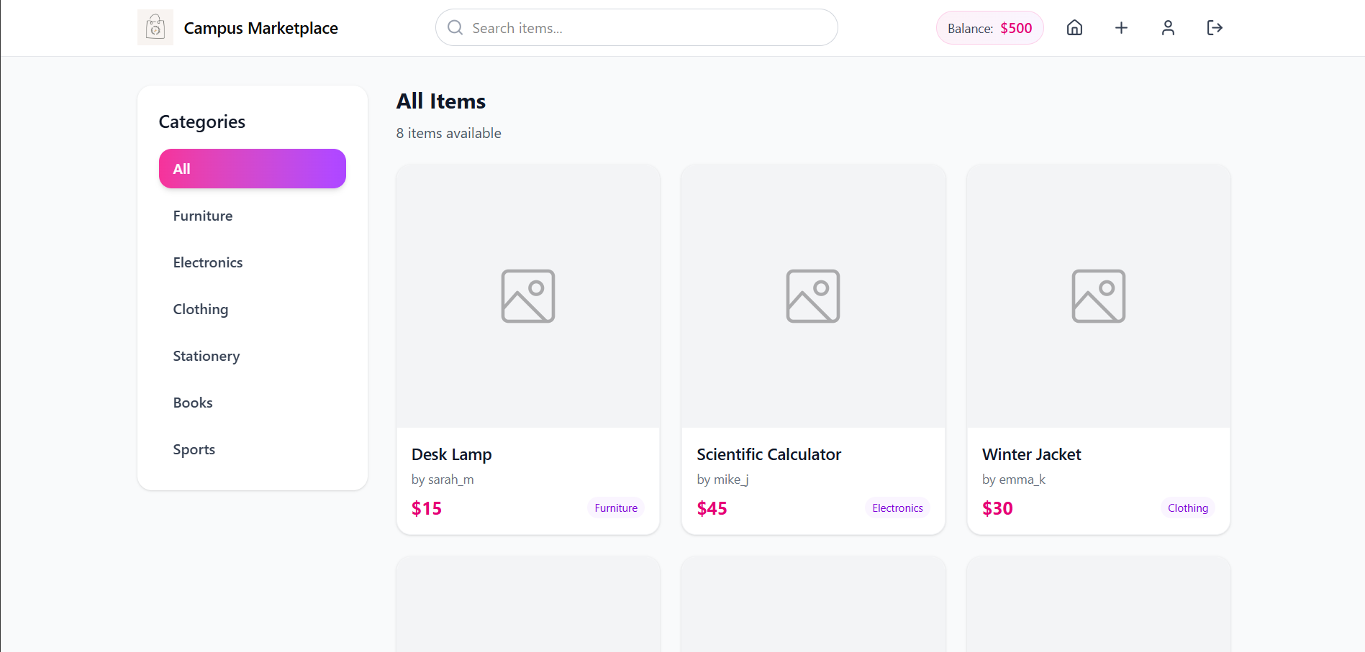
Wireframes (main)

Slide 15
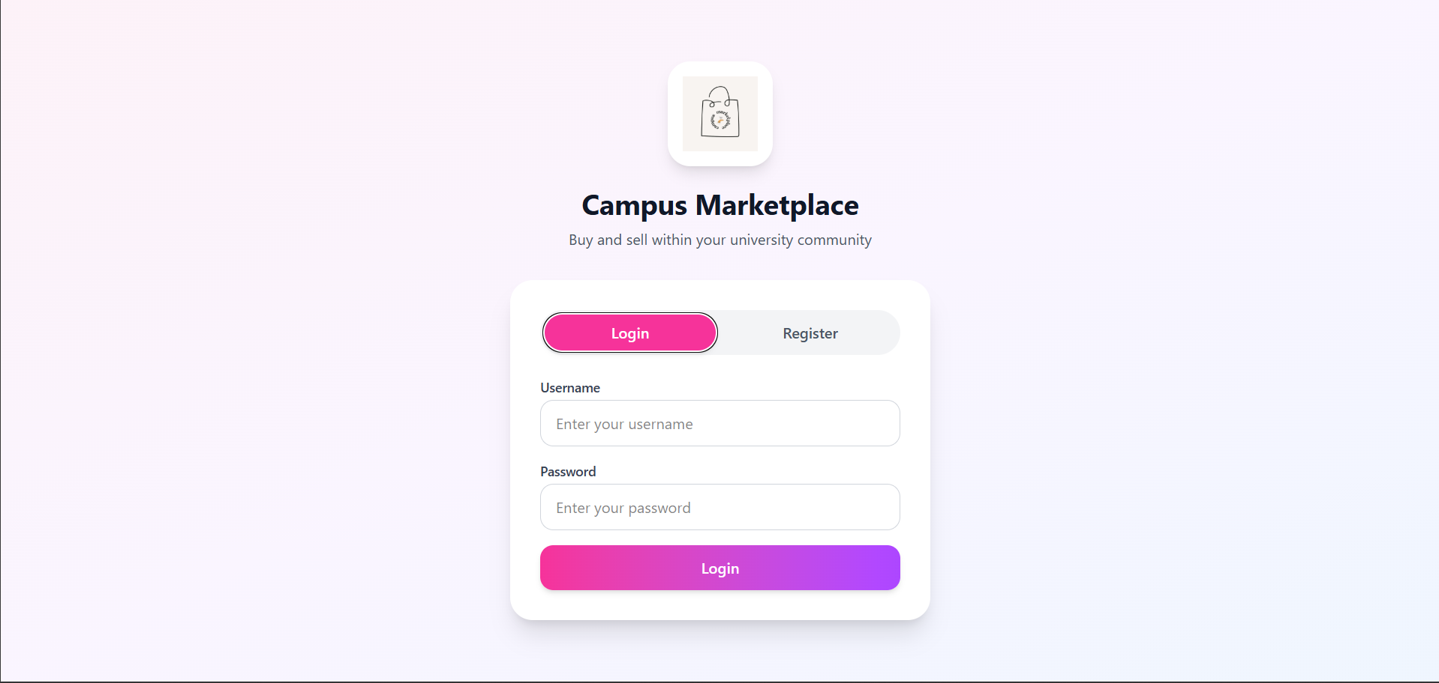
Wireframes (login)

Slide 16
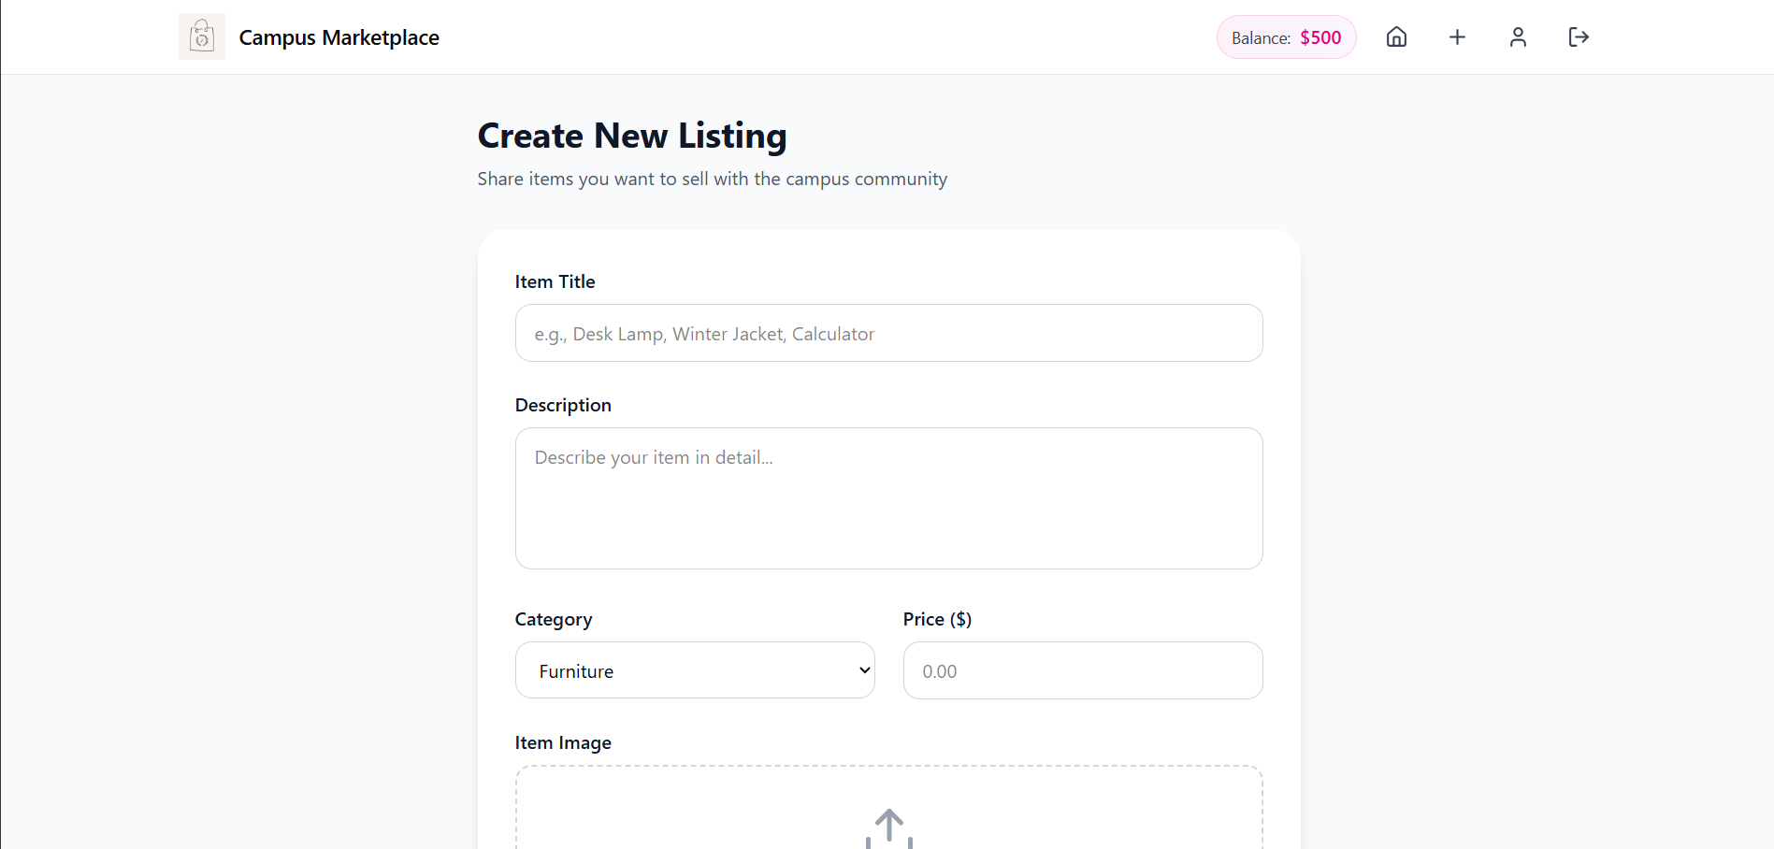
Wireframes (create listing)

Slide 17
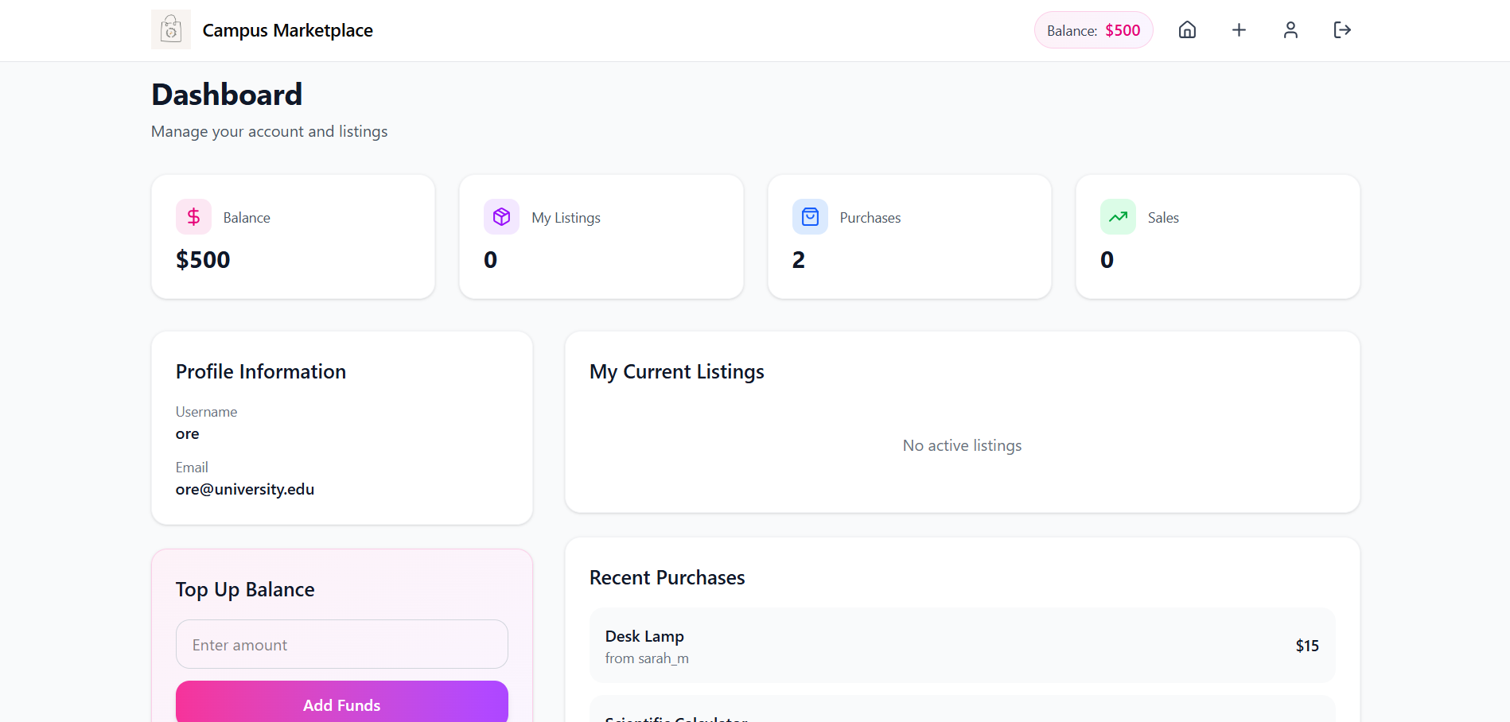
Wireframes (user dashboard)

Slide 18
Site URLs
/Shop
/Shop/*category*
/Shop/*Item*
/Shop/*Item*/purchase
/newItem
/SignUp
/login
/Account

Slide 19
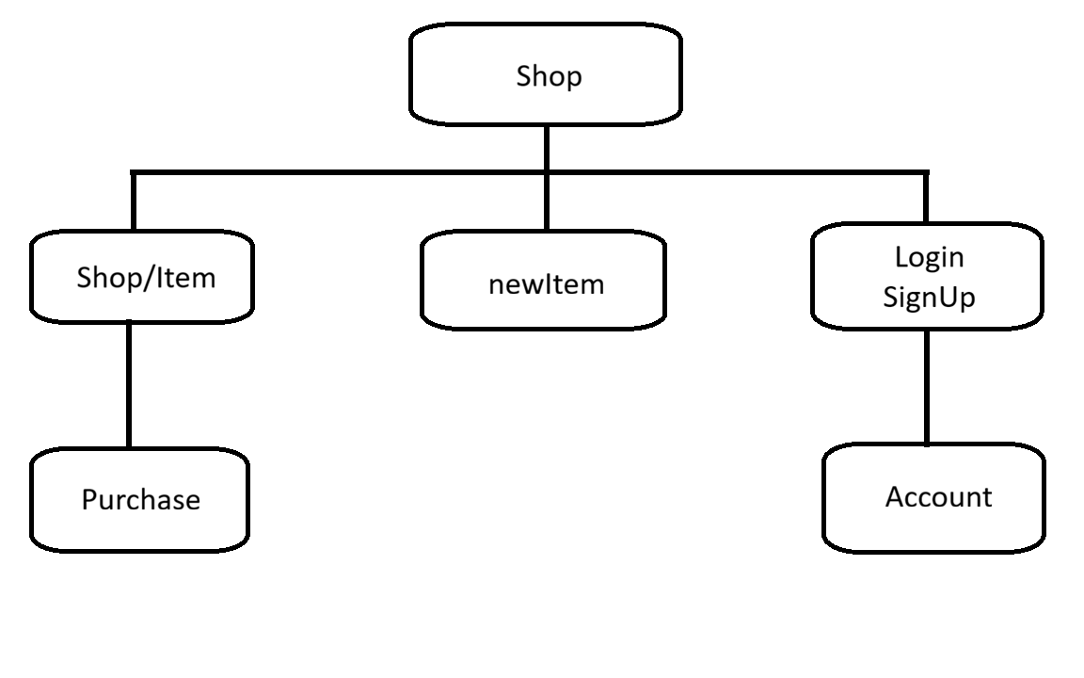
Site map

Slide 20
Thank you!

